Slide 1
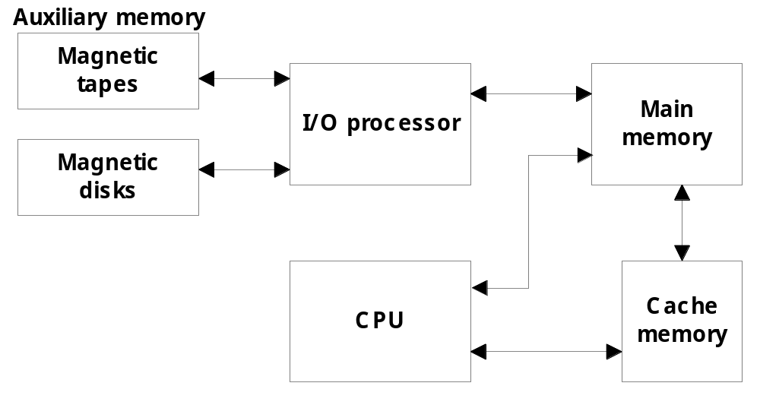
Memory Organization
Memory Hierarchy
  Memory hierarchy in a computer system :
    Main Memory : memory unit that communicates directly with the CPU (RAM)
    Auxiliary Memory : device that provide backup storage (Disk Drives)
    Cache Memory : special very-high-speed memory to increase the processing speed (Cache RAM)

Slide 2
Memory Organization
  Multiprogramming
    enable the CPU to process a number of independent program concurrently
  Memory Management System :
    supervise the flow of information between auxiliary memory and main memory
Memory Hierarchy is to obtain the highest possible access speed while minimizing the total cost of the memory system
Register
Cache
Main Memory
Magnetic Disk
Magnetic Tape

Slide 3
Random Access Memory (RAM)
  RAM Chips
  Static RAM
  Consists of Flip-flops to store binary information.
  Static RAM is easier to use and having short Read/Write cycles
  Used mostly in Cache memory.
  Dynamic RAM
  Stores binary information in the form of electric charge stored inside the capacitor.
  The capacitors are provided by MOS transistors.
  Refreshing circuit is required to refresh the memory.
  Dynamic RAM offers reduced power consumption and large storage capacity.
  It is used to construct main memory.
    Typical RAM chip :
      128 X 8 RAM : 2⁷ = 128 (7 bit address lines)
    Typical ROM chip:
      512 X 8 ROM : 2⁹ = 512 (9 bit address lines

Slide 4

Three State Buffer
Normal input A
Output Y=A if C=1
High-impedence if C=0
Control input C
Select
S₁
0
S₀
1
2×4 Decoder
A₀
2
Enable
E
3
B₀
C₀
Bus line with three-state buffer (replaces MUX0 in the previous diagram)
D₀

Slide 5
MAIN MEMORY
Main Memory
RAM and ROM Chips
Typical RAM chip
Chip select 1
CS1
Chip select 2
CS2
128 x 8
Read
RD
RAM
8-bit data bus
Write
WR
7-bit address
AD 7
CS1 CS2 RD WR
Memory function
State of data bus
0 0 x x
Inhibit
High-impedence
0 1 x x
Inhibit
High-impedence
1 0 0 0
Inhibit
High-impedence
1 0 0 1
Write
Input data to RAM
1 0 1 x
Read
Output data from RAM
1 1 x x
Inhibit
High-impedence
Typical ROM chip
Chip select 1
CS1
Chip select 2
CS2
512 x 8
8-bit data bus
ROM
9-bit address
AD 9

Slide 6
MEMORY ADDRESS MAP
Main Memory
Address space assignment to each memory chip
Example: 512 bytes RAM and 512 bytes ROM
Hexadecimal
address
Address bus
Component
10 9 8 7 6 5 4 3 2 1
RAM 1
RAM 2
RAM 3
RAM 4
ROM
0000 - 007F
0080 - 00FF
0100 - 017F
0180 - 01FF
0200 - 03FF
0 0 0 x x x x x x x
0 0 1 x x x x x x x
0 1 0 x x x x x x x
0 1 1 x x x x x x x
1 x x x x x x x x x
Memory Connection to CPU
- RAM and ROM chips are connected to a CPU
through the data and address buses
- The low-order lines in the address bus select
the byte within the chips and other lines in the
address bus select a particular chip through
its chip select inputs

Slide 7

CONNECTION OF MEMORY TO CPU
Main Memory
Address bus
CPU
16-11
10
9
8
7-1
RD
WR
Data bus
Decoder
3
2
1
0
CS1
CS2
128 x 8
Data
RD
RAM 1
WR
AD7
CS1
CS2
128 x 8
Data
RD
RAM 2
WR
AD7
CS1
CS2
128 x 8
Data
RD
RAM 3
WR
AD7
CS1
CS2
128 x 8
RD
RAM 4
Data
WR
AD7
CS1
1- 7
CS2
512 x 8
8
ROM
Data
9
AD9

Slide 8
Numerical Problems
Q1. a) How many 128x8 RAM chips are needed to provide a memory capacity of 2048 bytes.
b) How any lines of the address bus must be used to access 2048 bytes of memory. How many of these lines will be common to all chips.
c) How many lines must be decoded for chip select? Specify the size of decoders.
Q2. Extend the memory system of Fig.1 to 4096 bytes of RAM and 4096 bytes of RAM. List the memory-address map and indicate what size decoders are needed.
Q3. A computer employs RAM chips of 256x8 and ROM chips of 1024x8. The computer system needs 2K bytes of RAM, 4K bytes of ROM, and four interface units each with four registers. A memory-mapped I/O configuration used. The two highest-order bits of the address bus are assigned 00 for RAM, 01 for ROM, and 10 for interface registers.
How many RAM and ROM chips are needed.
Draw a memory-address map for the system.
Give the address range in hexadecimal for RAM, ROM and interface.

Slide 9
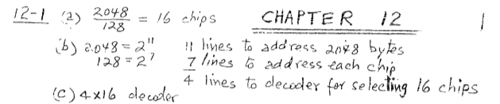
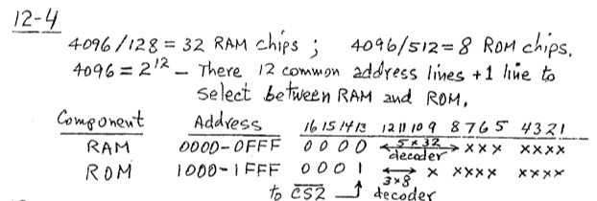

Slide 10
Cache Memory
12-5 Cache Memory
  Locality of Reference
    the references to memory tend to be confined within a few localized areas in memory
  Cache Memory : a fast small memory
    keeping the most frequently accessed instructions and data in the fast cache memory
  Hit Ratio
    the ratio of the number of hits divided by the total CPU references (hits + misses) to memory
      hit : the CPU finds the word in the cache
      miss : the word is not found in cache (CPU must read main memory)
  A computer with cache access time of 100ns, a main memory access time of 1000 ns, a hit ratio of 0.9 is having average access time of 200ns.

Slide 11
Types of Mapping of Cache Memory
  Mapping
    The transformation of data from main memory to cache memory
      1) Associative mapping
      2) Direct mapping
      3) Set-associative mapping
  Associative Mapping:
    main memory : 32 K x 12 bit word (15 bit address lines)
    cache memory : 512 x 12 bit word
      CPU sends a 15-bit address to cache
        Hit : CPU accepts the 12-bit data from cache
        Miss : CPU reads the data from main memory (then data is written to cache)

Slide 12
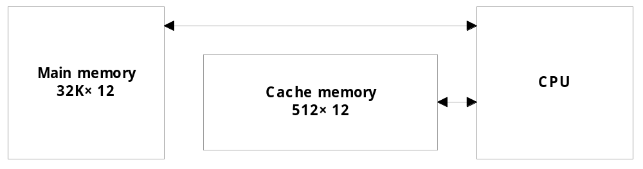
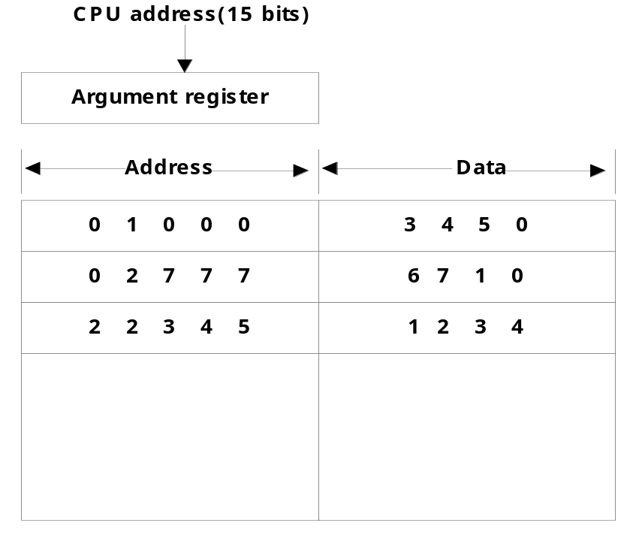
Associative Mapping

Slide 13
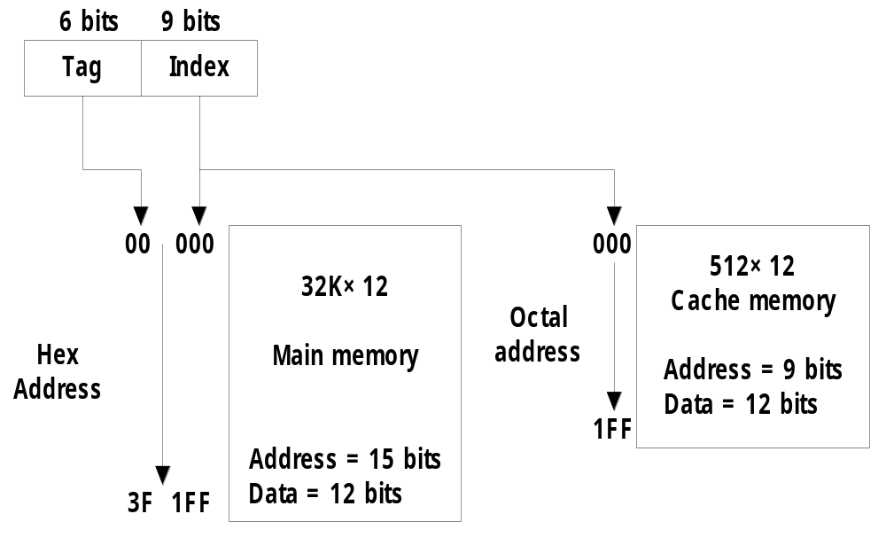
Direct Mapping
  Direct mapping :
    n bit memory address
    Tag field (n - k) : Index field (k)
    2^{k} words cache memory + 2^{n} words main memory
        Tag = 6 bit (15 - 9), Index = 9 bit

Slide 14
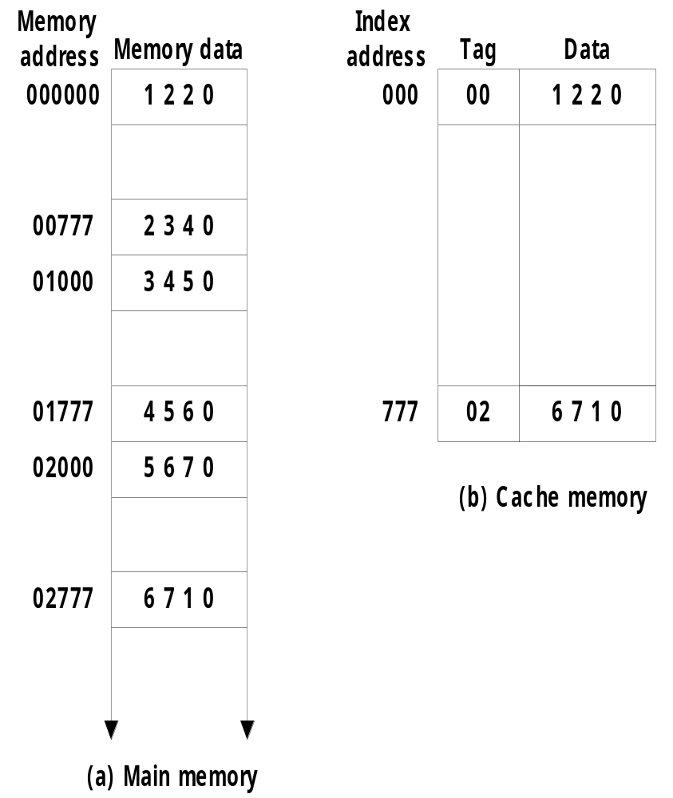
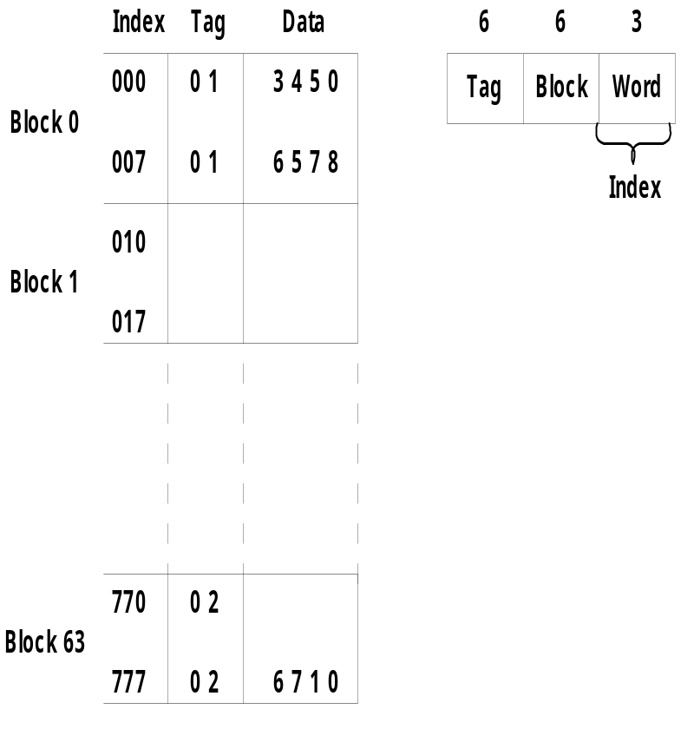
Direct Mapping
    Direct mapping cache with block size of 8 words :
      64 block x 8 word = 512 cache words size

Slide 15
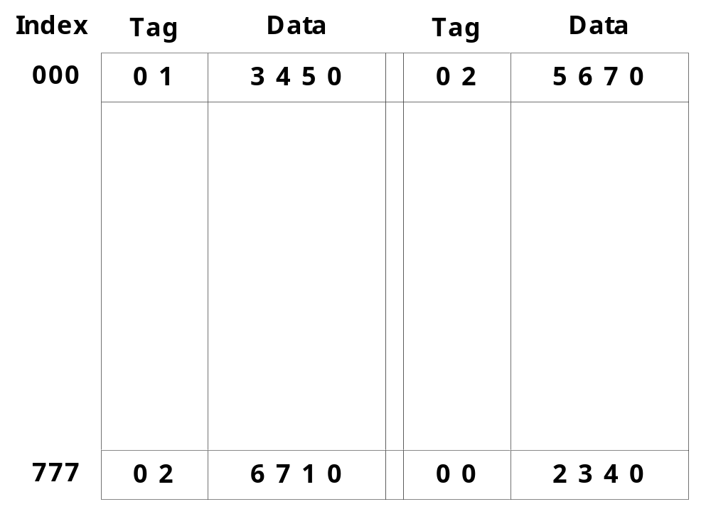
Set-Associative Mapping
  Set-associative mapping : (two-way)

Slide 16
Questions
A two-way set associative cache memory uses blocks of four words. The cache can accommodate a total of 2048 words from main memory. The main memory size is 128Kx32. Formulate all pertinent information required to construct the cache memory. What is the size of cache memory.
A computer has a memory unit of 64Kx16 and a cache memory of 1K words. The cache uses direct mapping with a block size of four words. How many bits are there in the tag, index, block, and words fields of the address format. How many bits are there in each word of cache, and how are they divided into functions? Include a valid bit. How many blocks can the cache accommodate?
The access time of a cache memory is 100ns and that of main memory is 1000ns. It is estimated that 80 percent of the memory requests are for read and the remaining 20 percent for write. The hit ratio for read access only is 0.9. A write-through procedure is used. What is the average access time of the system considering only memory read cycles. What is the average access time of the system for both read and write requests. What is the hit ratio considering the write requests also.

Slide 17
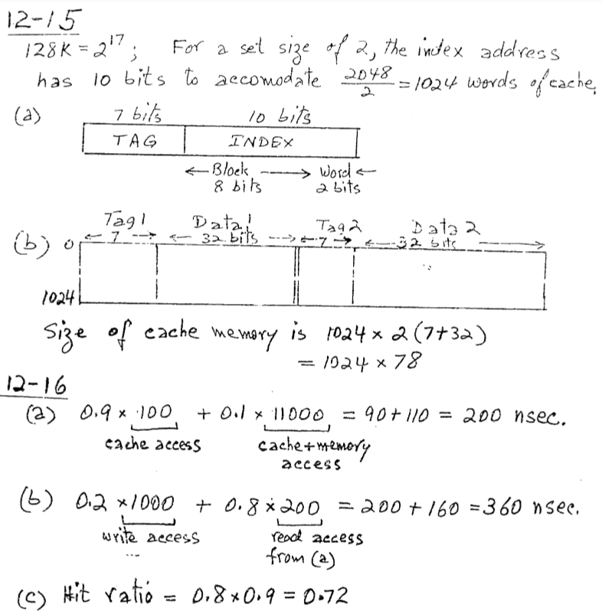
Answer

Slide 18
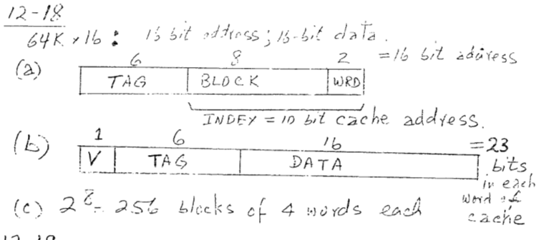
Answer

Slide 19
  Replacement Algorithm : cache miss or full
    1) LRU (Least Recently Used):
    2) Random Replacement:
    3) FIFO (First-In First-Out) :
  Writing to Cache :
      1) Write-through :
      2) Write-back :
  Cache Initialization
    Cache is initialized :
      1) When power is applied to the computer
      2) When main memory is loaded with a complete set of programs from auxiliary memory
      3) Cache is initialized by clearing all the valid bits to 0.
    Valid bit
      Indicate whether or not the word contains valid data

